Slide 1

ONLINE SWEETMART

Slide 2
Architecture
ADMIN
USER
MODULE
CART
MODULE
CATEGORY
MODULE
ORDER MODULE
PAYMENT METHOD
MODULE
PRODUCT
MODULE

Slide 3
ADMIN
ER DIAGRAM
ID
Name
Password
PRODUCT
CATEGORY
Id
Name
Qty
Description
Price
Available
Id
Name
USER
User_ ID
User_name
Password
User_email
OrderModule
OrderId
UserId
OrderStatus
OrderDate
Address
CartId
TotalCost
PAYMENT
CART
CartId
UserId
ProductCount
Total
ProductId
OrderId
TransactionId
PaymentMethod
Totalcost
PaymentStatus

Slide 4
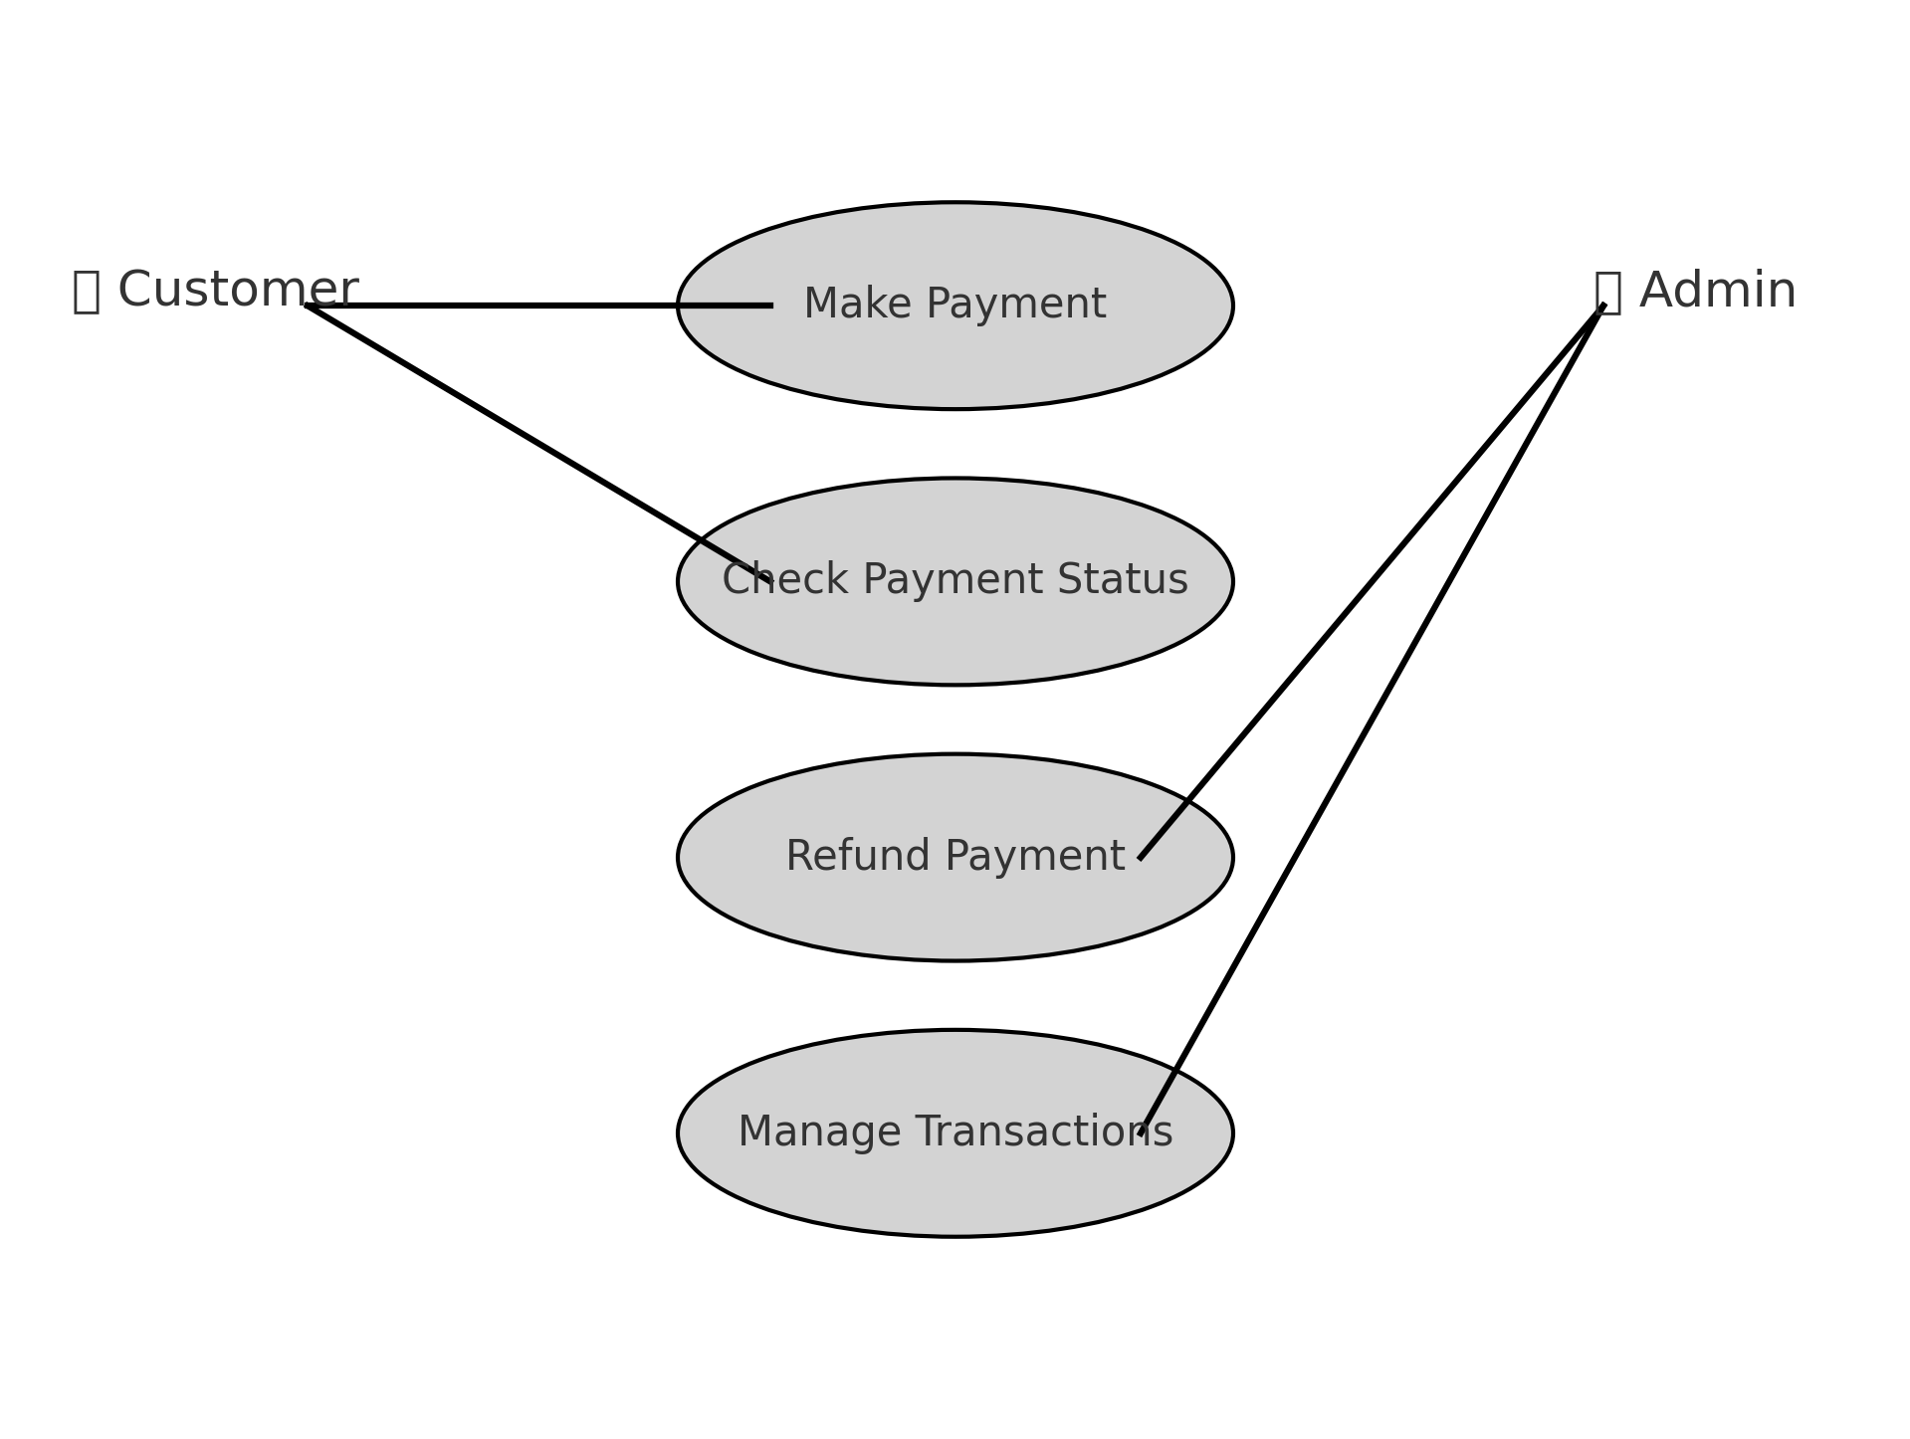
UseCaseDiagrams

Slide 5
ClassDiagram
gg
OrderDTO
payment
+id
+totalcost
+status
+processPayment()
+ordered
+totalcost
+getOrderdetails
paymentController
n
PaymentService
+service:PaymentService
+repo:PaymentRepository
+makePayment()
+getStatus()
+processPayment
+checkStatus
Exception
+message
+handleError()

Slide 6


Slide 7
THANK YOU

